Slide 1

Arte generativa
Ordine e Caos
Codice Inutile Alka Cappellazzo

Slide 2
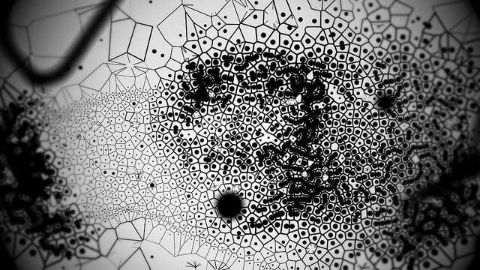

Generative Art È tutto ciò che si realizza tramite algoritmi. Si tratta di un processo di creazione con input e output.
Raven Kwok, https://vimeo.com/139977231

Slide 3
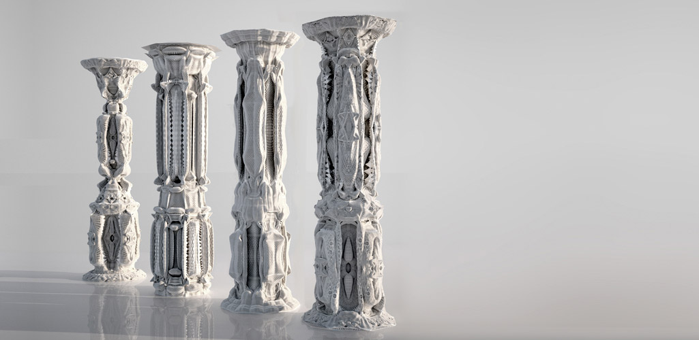
Arte generativa: utopia o realtà? Il campo non è ristretto esclusivamente all’Arte, ma si applica anche al Design e all’Architettura.
Michael Hansmeyer, http://www.michael-hansmeyer.com/projects/columns.html?screenSize=1&color=1

Slide 4
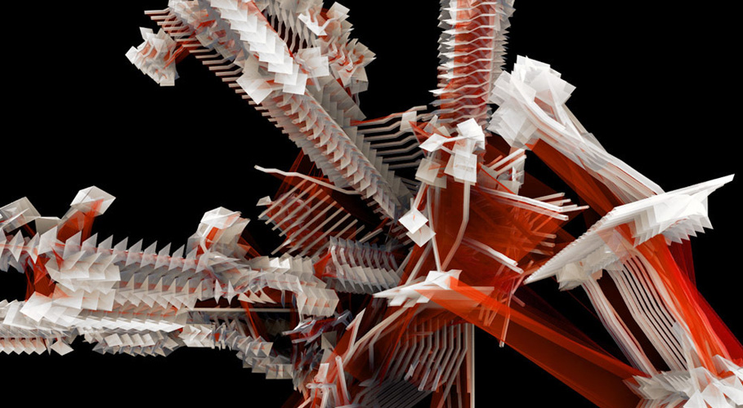
L-systems
Michael Hansmeyer, L-systems, http://www.michael-hansmeyer.com/projects/l-systems.html?screenSize=1&color=1#5

Slide 5

L-systems: frattale di Cantor
Link Daniel Shiffman: https://www.youtube.com/watch?v=f6ra024-ASY

Slide 6
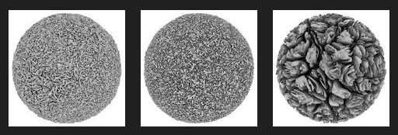
Cellular Forms
Andy Lomas, http://www.andylomas.com/cellularFormImages.html
Cellular Forms: https://vimeo.com/93056665

Slide 7
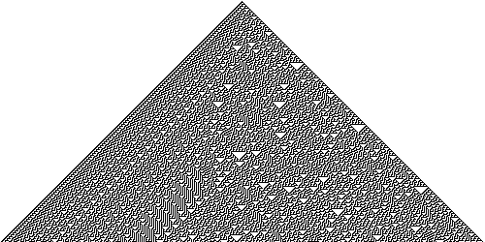
Cellular Automata
Rule 30 cellular automaton, Stephen Wolfram.

Slide 8
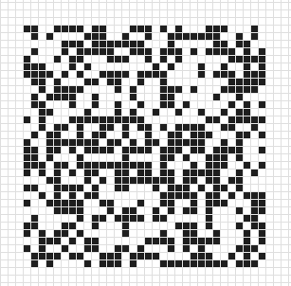
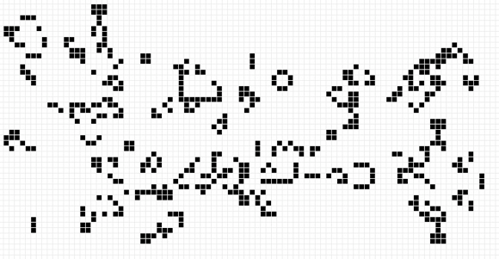
Game of life: dead or alive
Conway’s game of life.
Mathematrec,
https://mathematrec.wordpress.com/

Slide 9
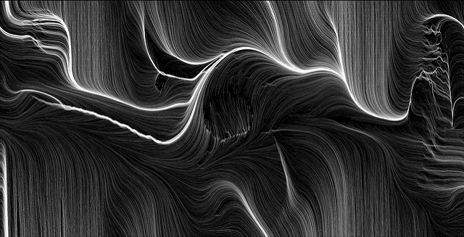
Altre applicazioni: amazing boook cover
Leonardo Soolas, https://www.flickr.com/photos/solaas/sets/72157613484932009

Slide 10
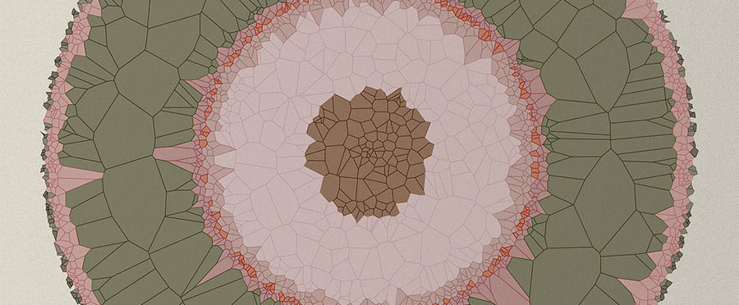
Diana Lange: Voronoi Diagram
Diana Lange, http://www.diana-lange.de/
Audio and video reaction, https://vimeo.com/24133373

Slide 11
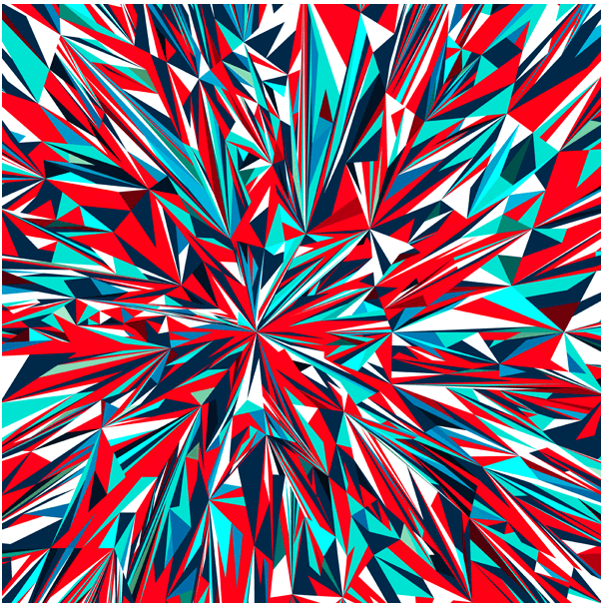
Marius Watz
Marius Watz, UCracking01
Stockspace: https://vimeo.com/138424873

Slide 12
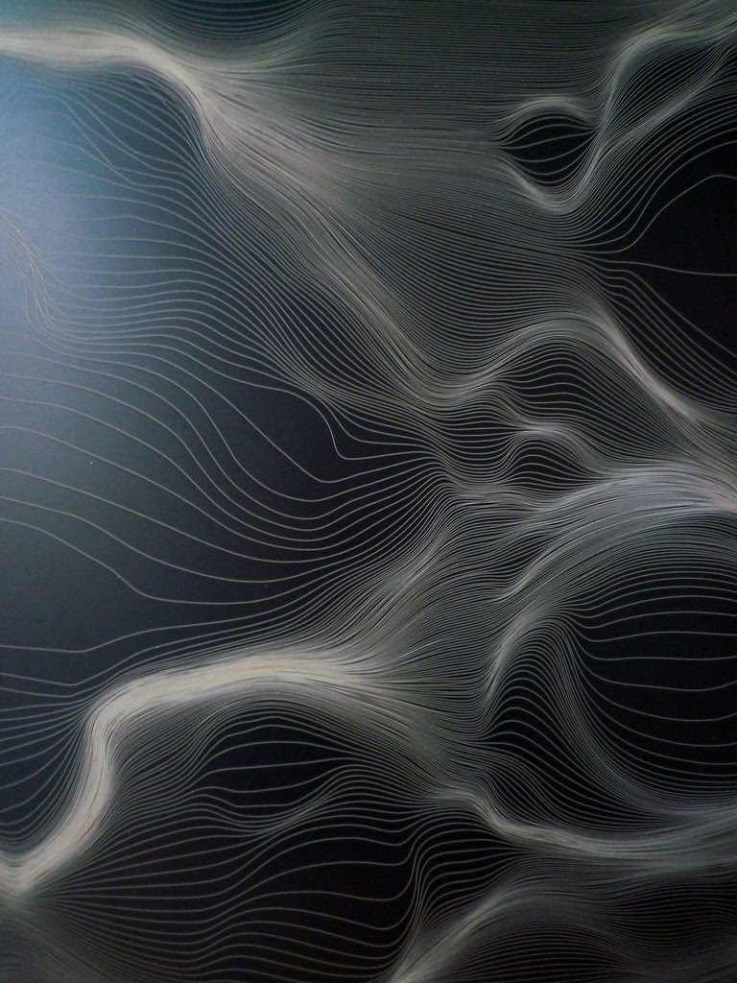
Marius Watz
“Solitamente il processo creativo è un momento irrazionale di transustanziazione, senza dubbio un momento di meraviglia.”
Intervista di Elena Ravera, Digicult.
Marius Watz, Grid Distortion, http://mariuswatz.com/2011/10/20/grid-distortion-02ab-0064/

Slide 13
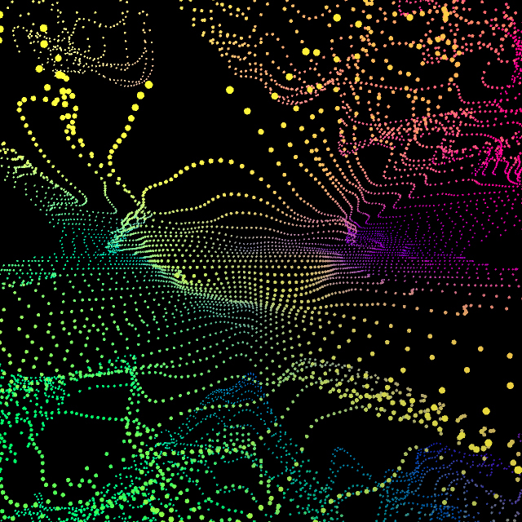
Joshua Davis
Joashua Davis, Oblivion Noise Field https://vimeo.com/59243441
Signature series: https://www.youtube.com/watch?v=-iKkEpW0N5Q

Slide 14
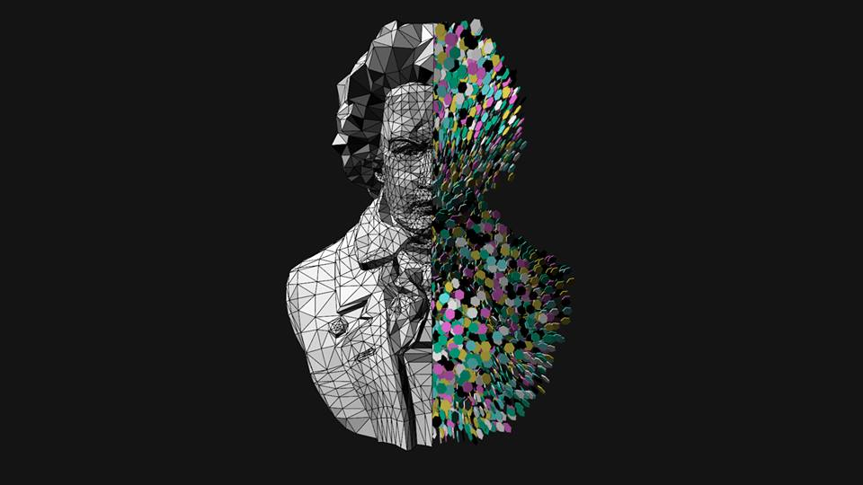
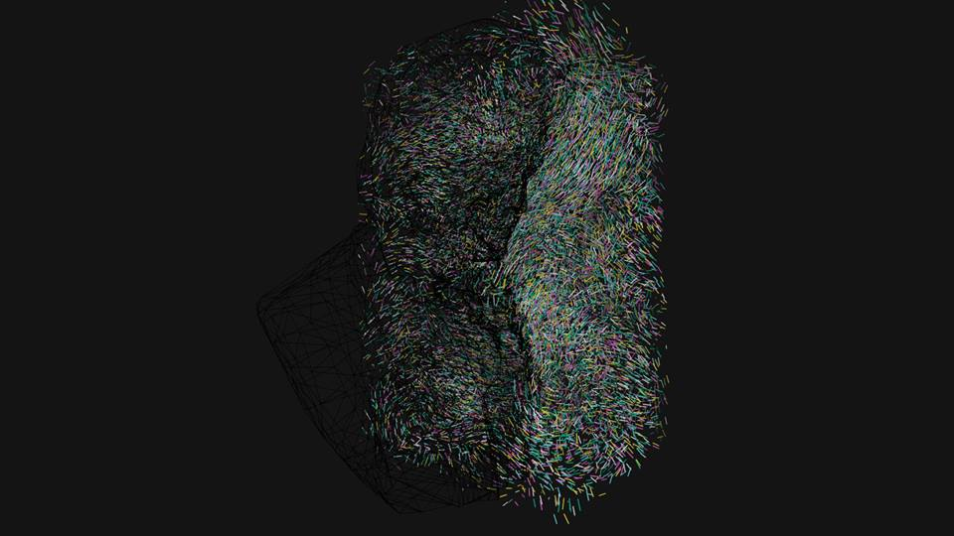
Frederik Vanhoutte
“Creative coding is about wonder, about exploration, about learning.”
Frederik Vanhoutte, HE_Mesh: http://www.wblut.com/
Trefoil MCB: https://www.youtube.com/watch?v=ihXZ2d2_b3U

Slide 15
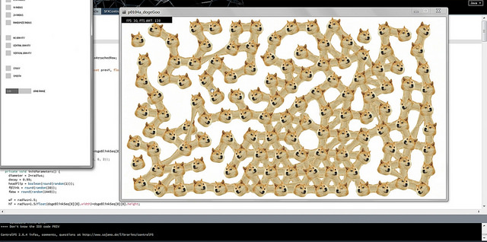
Raven Kwok
Raven, Kwok, Doge Goo, https://vimeo.com/116684966
1DDCB, https://vimeo.com/150841540
Karma Fields, https://vimeo.com/121096680
Landscape Demo, https://vimeo.com/15858740

